Slide 1
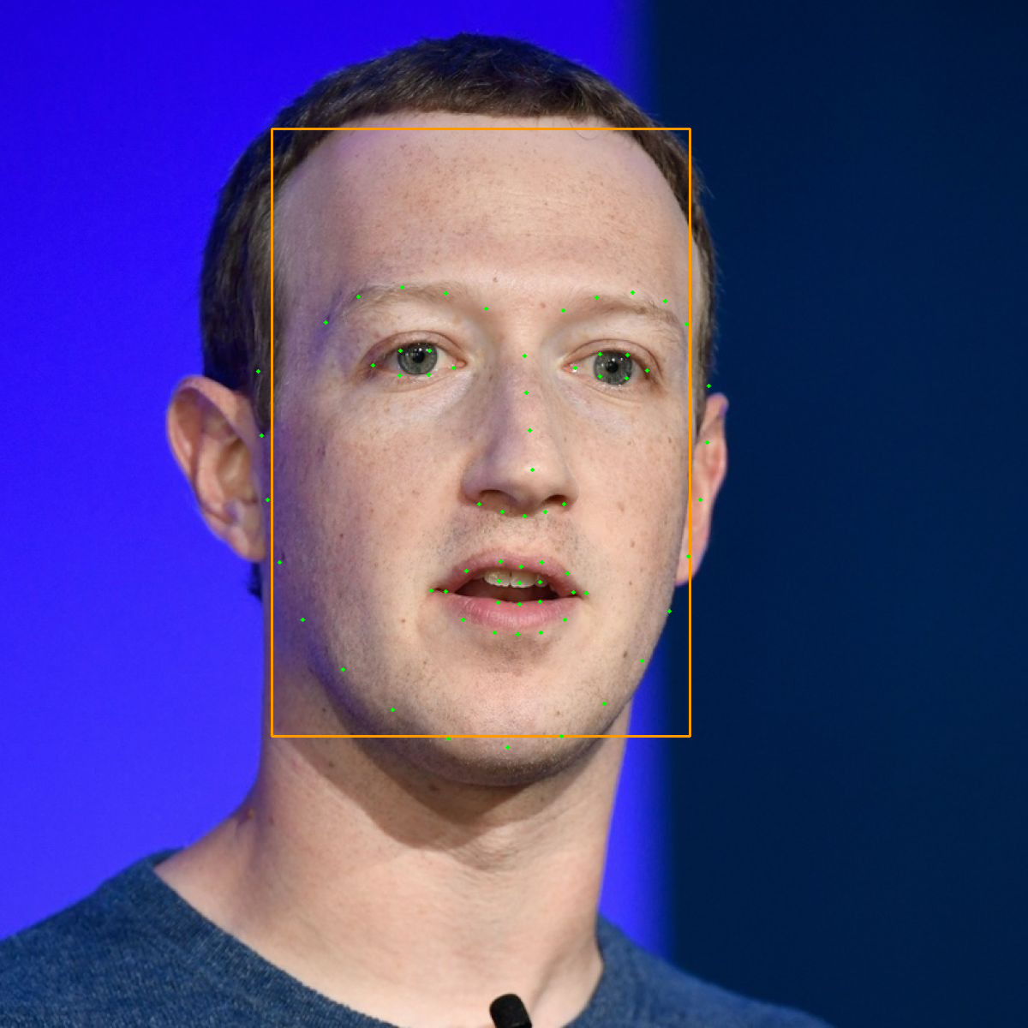
Facial Recognition From Images
Yusuf ANI <xaniyu00@stud.fit.vutbr.cz>
yusufani8@gmail.com
December 26, 2020

Slide 2
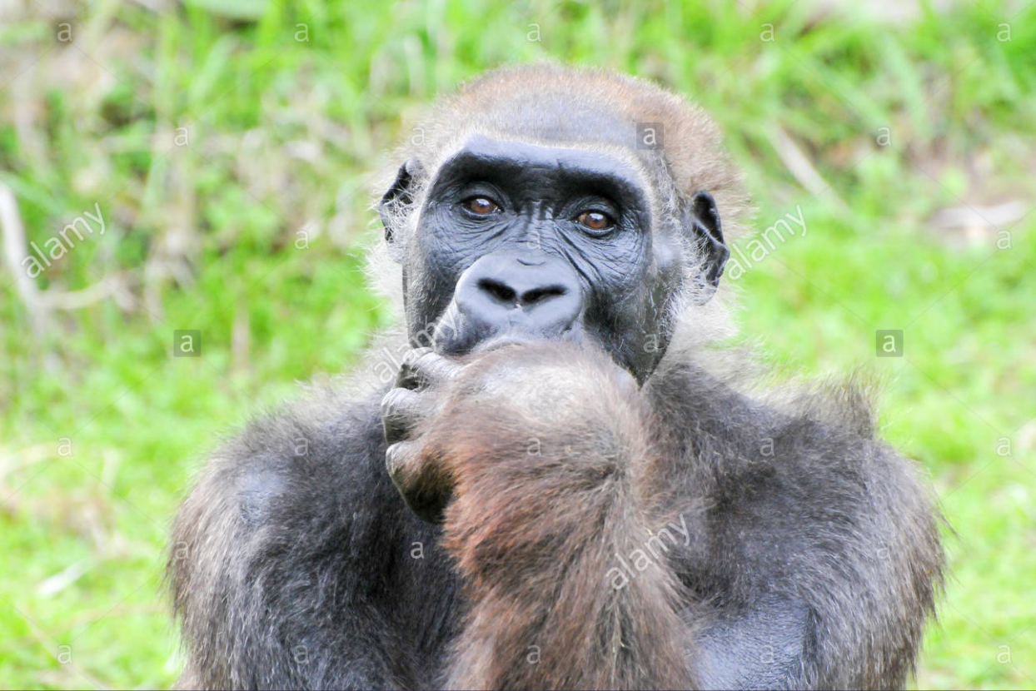
What is the Problem and why I have chosed this task
Finding the best model duo
What I am looking For:
More Accurate Models
Fast Models

Slide 3
Approach
We can divide steps into 2 tasks
Detecting Faces
Extracting Facial Landmarks

Slide 4
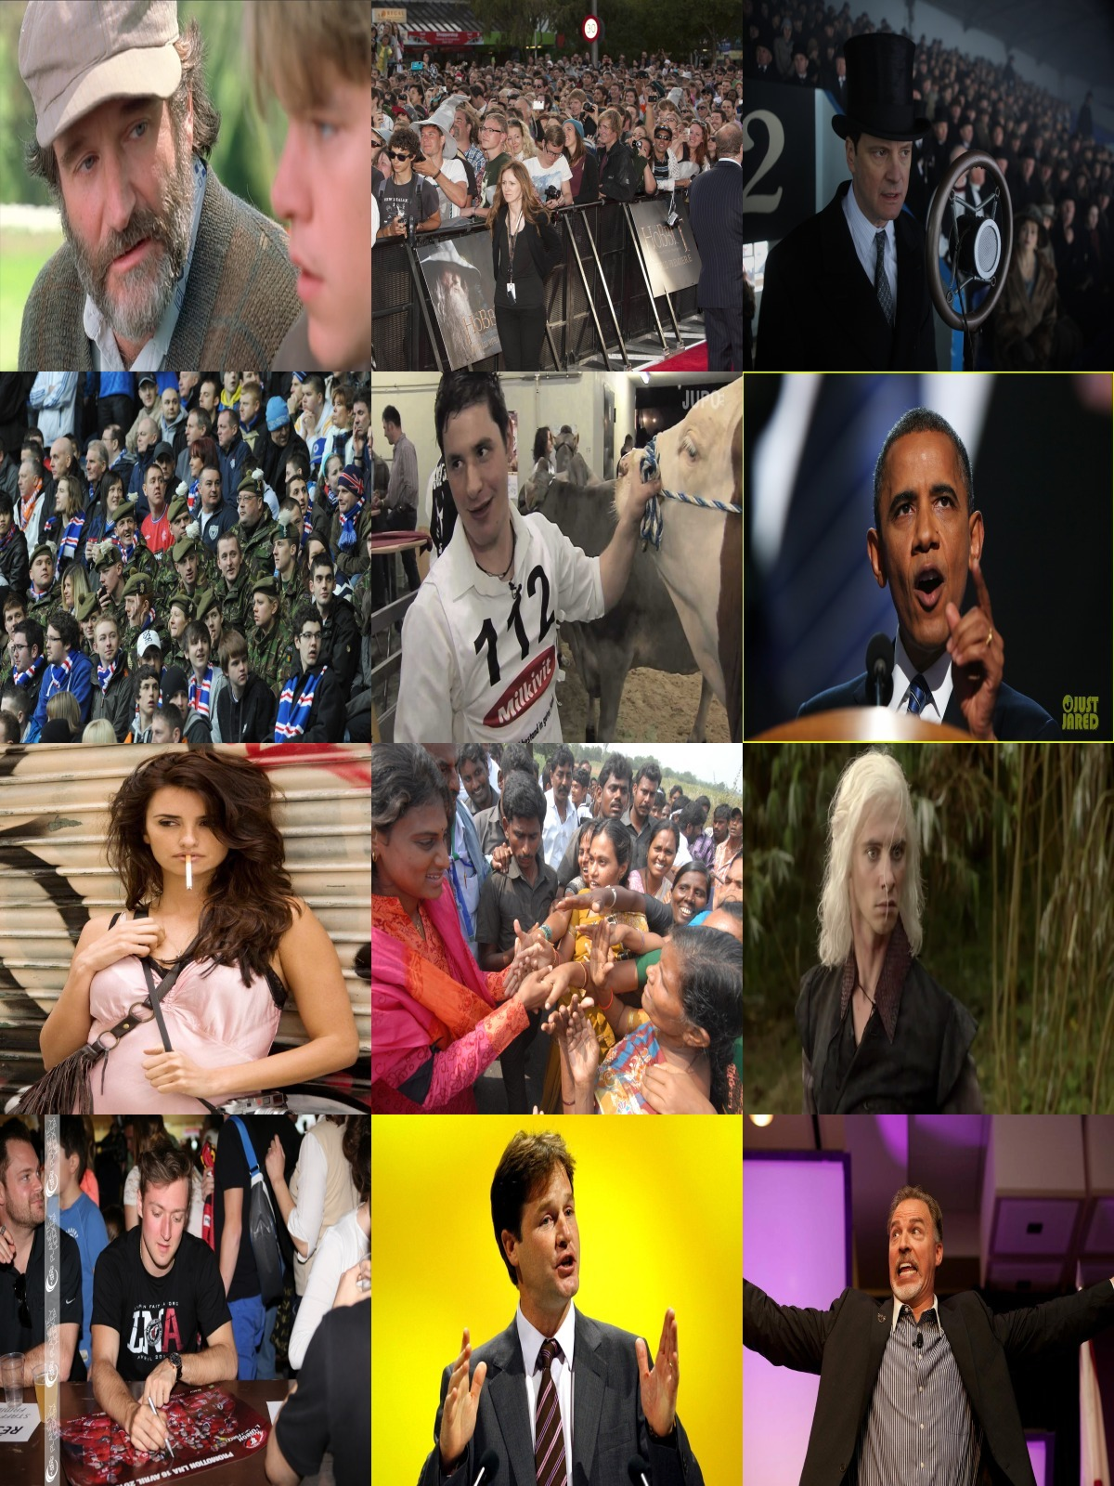
DATASET
300W
300 indoor images + 300 outdoor images
Different sizes
With facial Landmark informations

Slide 5
Used Models
Face Detector Models
Face Alignment
Models
MTCNN
DNN Frontal Face
Haar Cascade Detector
Dlib HOG Based Detector
CNN Facial Landmark Extractor
Dlib Facial Landmark Extractor

Slide 6
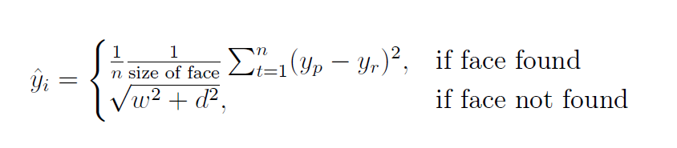
Calculating Error

Slide 7
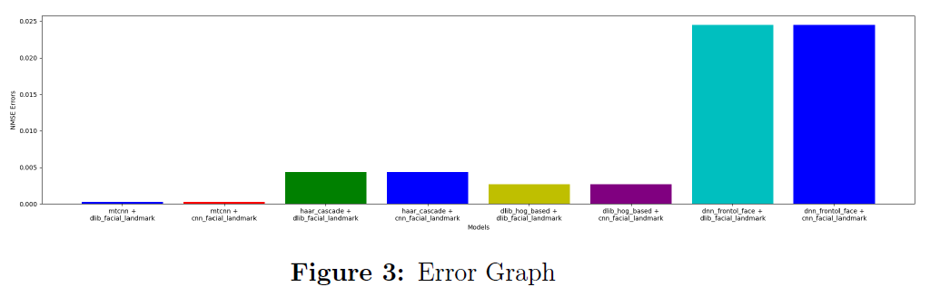
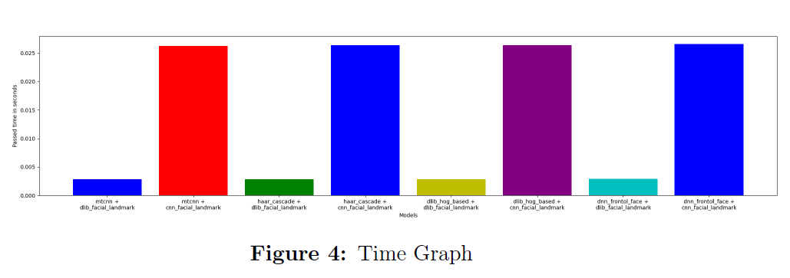
Results

Slide 8
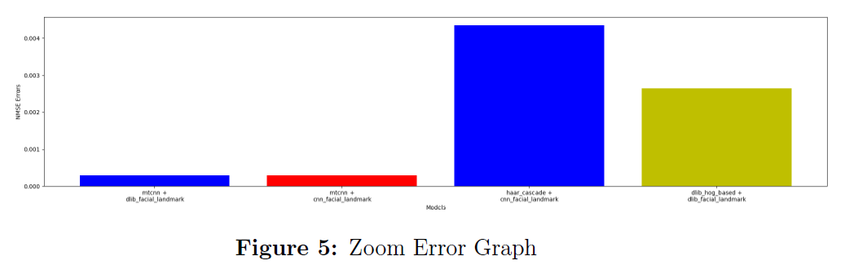
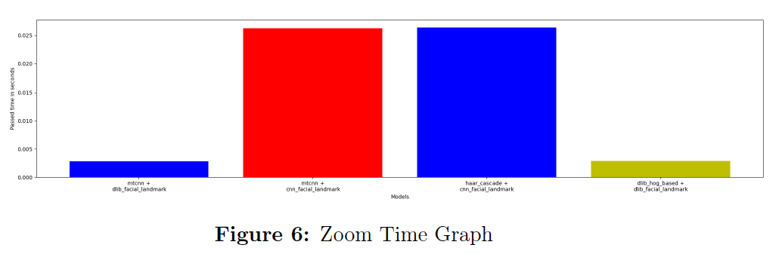
Conclusion Winner is mtcnn + dlib facial landmark
Challenges
Lack of Experience
Finding General Formula
Working alone

Slide 9
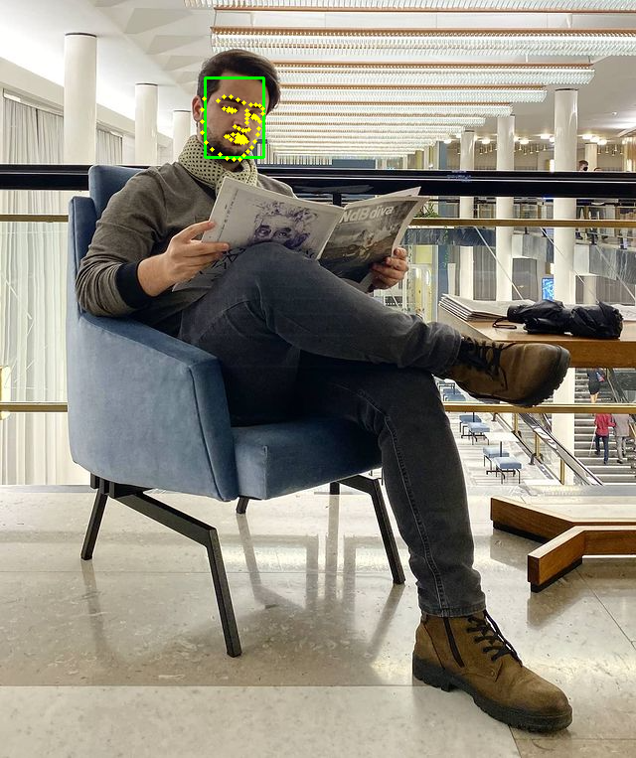
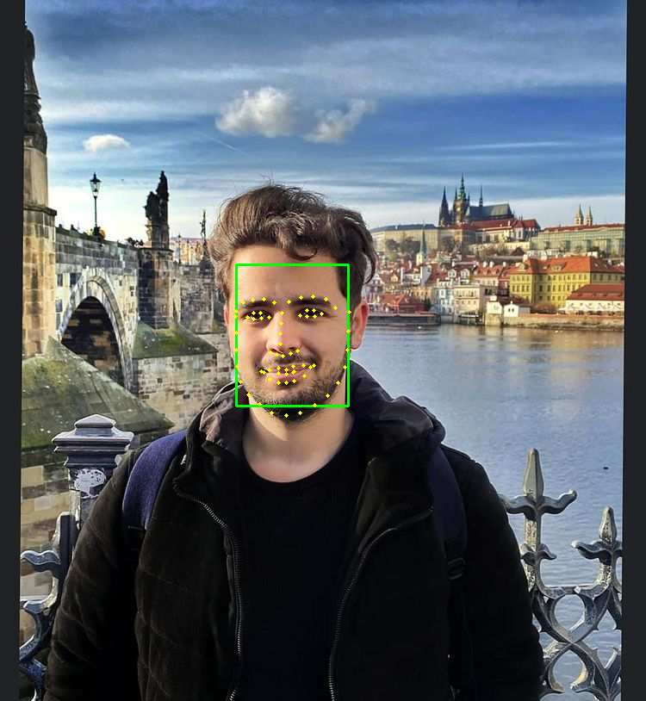
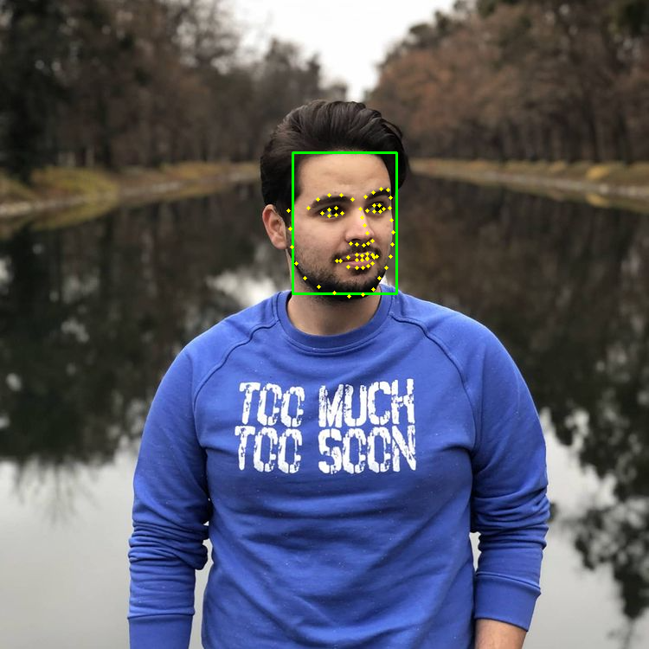
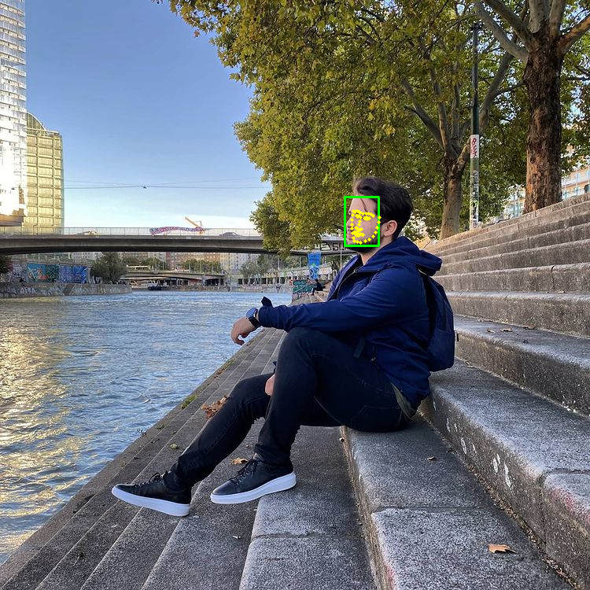
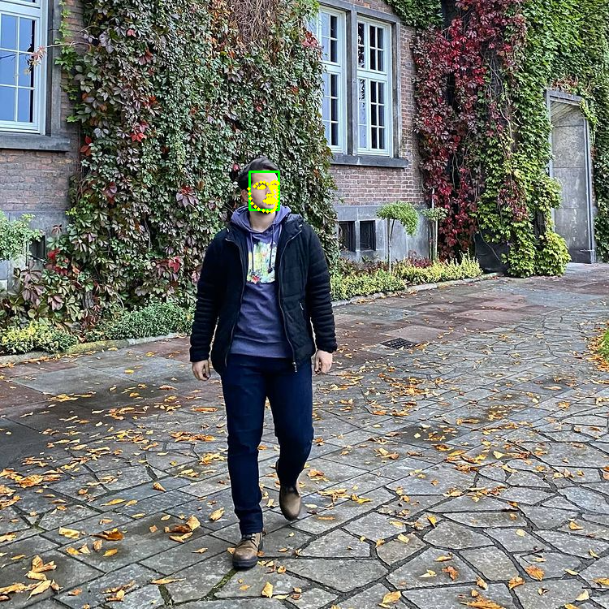
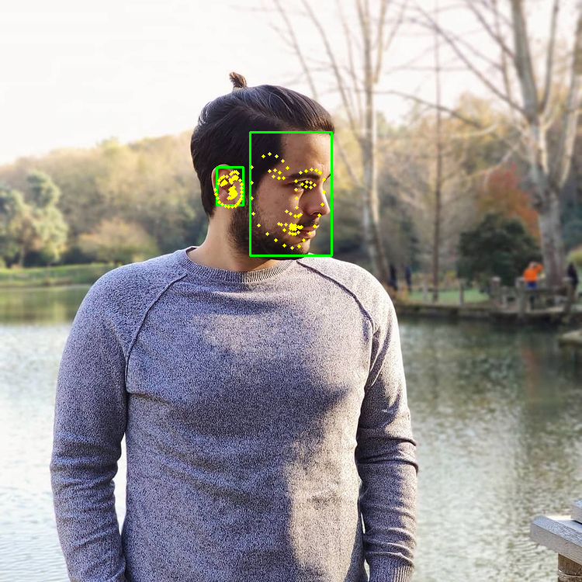
Results on me

Slide 10
Thanks For Listening

